Slide 1
Medical Terminology
Prefix : Suffix : Combining Forms

Slide 2
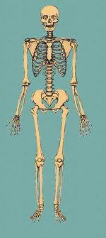
Anatomical Position
the body is assumed to be standing, the feet together, the arms to the side, and the head and eyes and palms of the hands facing forwards.

Slide 3
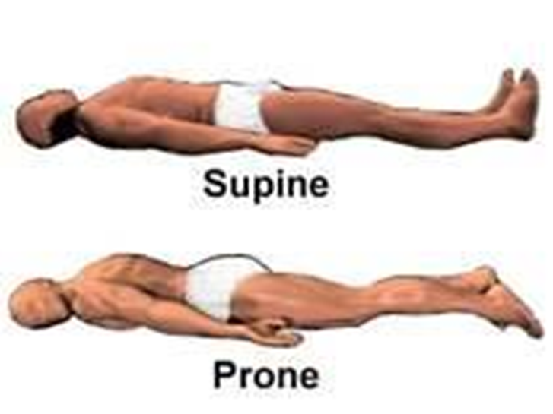
Prone
Lying on the front or ventral side of the body

Slide 4
Supine
Lying on the back or dorsal side of the body

Slide 5
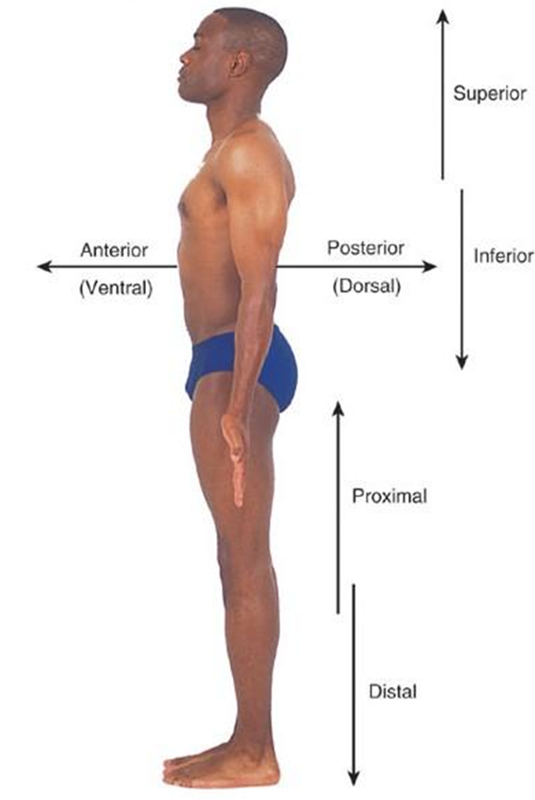
Anterior / Ventral
In front of or before

Slide 6
Posterior / Dorsal
Towards the back or rear

Slide 7
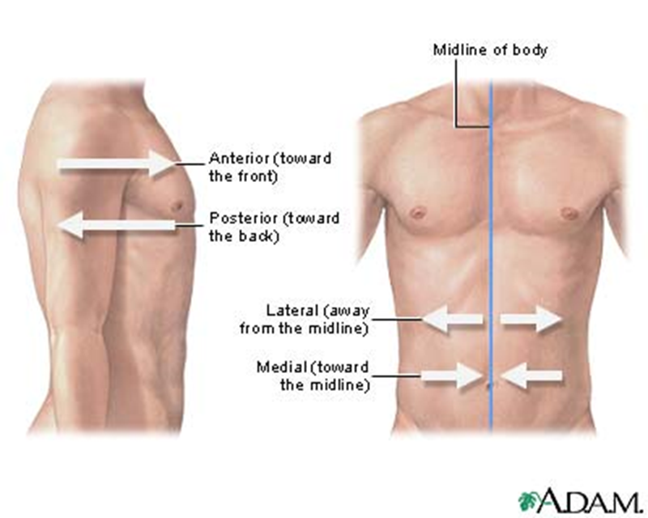
Medial
Pertaining to the Point of reference
Closest to the midline of the body

Slide 8
Lateral
Pertaining to the point of reference away
From the midline of the body

Slide 9
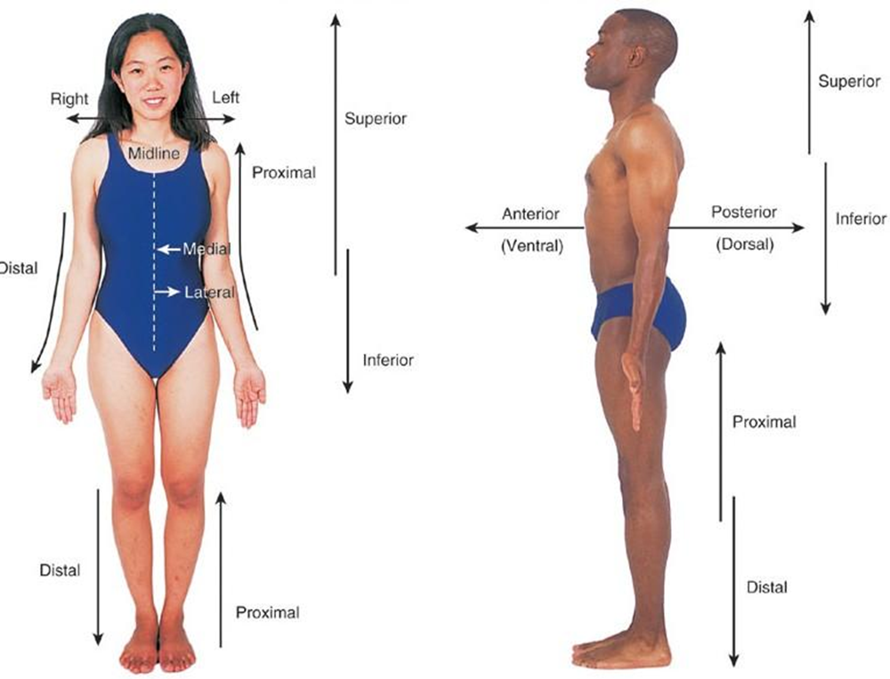
Superior
Above or on top of the point of
Reference.

Slide 10
Inferior
Below the point of reference
or towards the feet

Slide 11
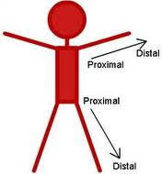
Proximal
Nearest to the point of reference

Slide 12
Distal
Farthest away from the point of reference

Slide 13
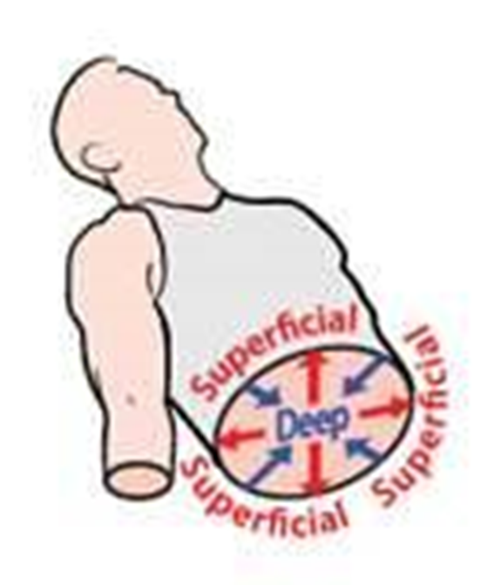
Deep
Away from the surface or further into the body

Slide 14
Superficial
Pertaining to the surface or shallow part

Slide 15
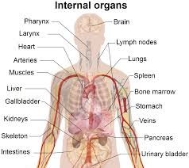
Internal
Pertaining to inside the body

Slide 16
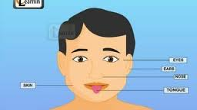
External
Outside of the body

Slide 17
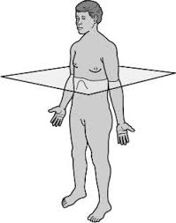
Transverse Plane
A horizontal line passing through the body so that it is parallel to the floor

Slide 18
Sagittal Plane
A vertical line that passes through the body from front to back

Slide 19
Mid-Sagittal Plane
The mid-sagittal, or median plane, splits the body into left and right halves

Slide 20
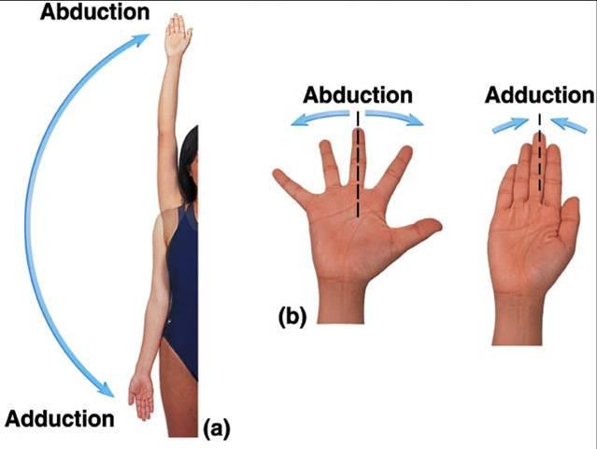
ab-
Def: Away from
Ex: abduction
(the process of carrying away from)
Movement of a limb away from the body

Slide 21
ad-
Def: toward
Ex: adduction
(the process of carrying toward)
Movement of a limb toward the midline
(Median axis) of The body

Slide 22
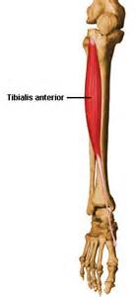
ante-
Def: forward, in front of
Ex: anterior
(the anterior tibialis is the muscle located in front of the Tibia Bone)

Slide 23
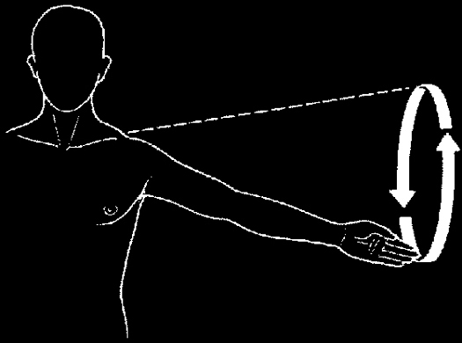
circum-
Def: around
Ex: circumduction
(the act of moving a limb in a circular motion)

Slide 24
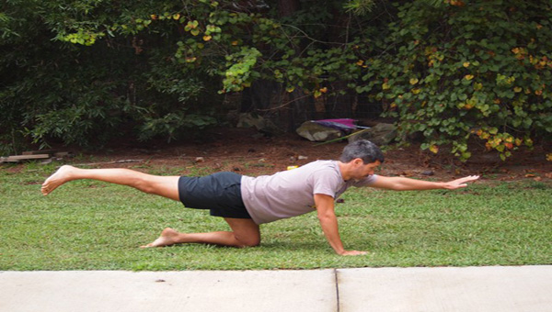
contra-
Def: opposite, against
Ex: contralateral
(pertaining to the opposite side)
Affecting or originating on the opposite side of a point of reference, such as a point on a body.

Slide 25
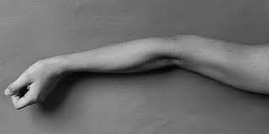
hyper-
Def: excessive, above
Ex: hyperextension
(the process of excessive stretching out)
Movement of a joint beyond the joint’s normal Range

Slide 26
hypo-
Def: deficient, below, under, decreased
Ex: hypothermia
(the process of having low body temperature )

Slide 27
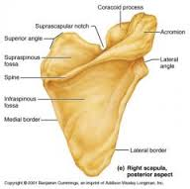
infra-
Def: down
Ex: infraspinous fossa
(pertaining to below the spine)
The large triangular region of the posterior scapula below the spine.

Slide 28
infra-
Def: down
Ex: infraspinous fossa
(pertaining to below the spine)
The large triangular region of the posterior scapula below the spine.

Slide 29
bilateral
Pertaining to both sides of the body

Slide 30
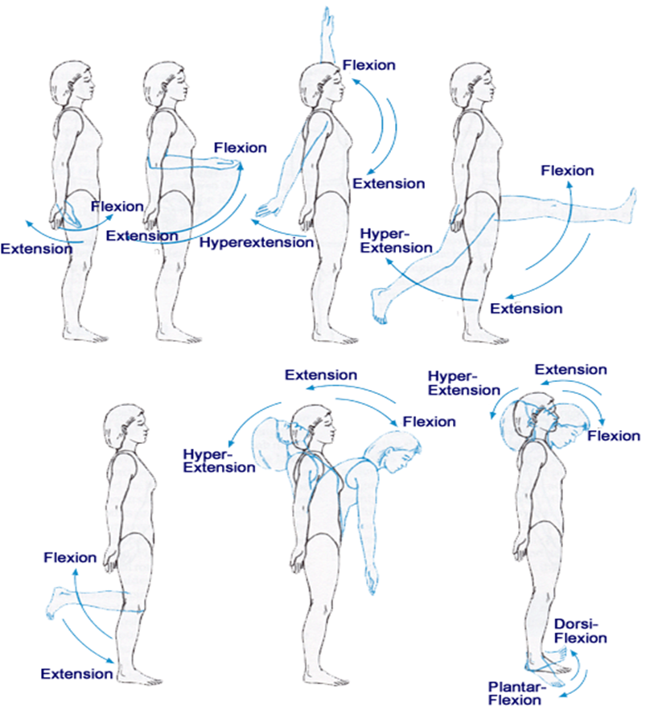
Flexion
The process of bending or the
state of being bent

Slide 31
Extension
The process of straightening

Slide 32
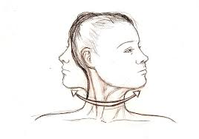
Rotation
Turning around an axis in an angular motion

Slide 33
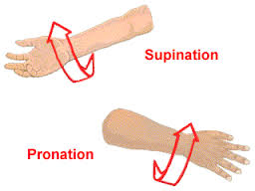
Pronation
Rotation of the forearm and hand so that the palm is down

Slide 34
Supination
Rotation of the forearm and hand so that the palm is face up

Slide 35
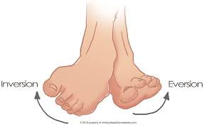
Inversion
To turn the foot inward toward the midline of the body

Slide 36
Eversion
To turn the foot outward away from the midline of the body

Slide 37
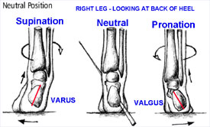
Valgus
Bent outward

Slide 38
Varus
Bent inward

Slide 39
Soft tissue
Includes muscles, fascia, tendons, joint capsules, ligaments, blood vessels, and nerves

Slide 40
fascia
Fibrous membrane that covers, supports and separates muscles.

Slide 41
Joint capsule
Sac-like structure that encloses the ends of bones

Slide 42
Eccentric contraction
Simultaneous processes of muscle contraction and stretching of the muscle-tendon unit by an extrinsic force

Slide 43
Concentric contraction
Occurs when a muscle shortens and there is movement at the joint accompanied by the contraction against resistance

Slide 44
Injury
An act that damages or hurts

Slide 45
Accident
An act that occurs by chance or without intention

Slide 46
Catastrophic Injury
One involving damage to the brain and/or spinal cord that presents a potentially life-threatening situation or the possibility of permanent disability.

Slide 47
Point Tenderness
Pain produced when the site of injury is palpated

Slide 48
contusion
Bruise or injury to soft tissue that does not break the skin

Slide 49
Hemorrhage
Discharge of blood

Slide 50
Ecchymosis
Black and blue discoloration of the skin caused by a hemorrhage

Slide 51
Hematoma
Localized collection of blood, usually clotted and confined with an organ, tissue or space

Slide 52
Chronic
An injury with a Slow onset and long duration

Slide 53
Acute
An injury with a sudden onset and short duration

Slide 54
Joint
Point at which two bones join together

Slide 55
Ligament
Connects bone to bone

Slide 56
Tendon
Connects muscle to bone

Slide 57
Sprains
Injury to a ligament that connects bone to bone

Slide 58
Strains
A stretch, tear, or rip in the muscle or tendon

Slide 59
Dislocation
A bone is forced out and stays out until surgically or manually replaced or reduced

Slide 60
Subluxations
A bone is forced out but goes back into place

Slide 61
Fracture
A break or crack in a bone

Slide 62
Avulsion
Forcible tearing away or seperation

Slide 63
“-itis"
Inflammation of …

Slide 64
Tendonitis
Inflammation of the tendon

Slide 65
Tenosynovitis
Inflammation of the tendon and its synovial sheath

Slide 66
Bursitis
Inflammation of the bursa, especially those bursae located between a bony prominences and a muscle or tendon.

Slide 67
Contusion
Bruise or injury to soft tissue that does not break skin.

Slide 68
Laceration
A cut.

Slide 69
Incision
A precise cut through skin or other tissue with smooth edges

Slide 70
Avulsion
Forcible tearing away or separation

Slide 71
Puncture
An injury that is caused by a pointed object that pierces or penetrates the skin

Slide 72
Aerobic
Oxygen required

Slide 73
Anaerobic
Not requiring oxygen

Slide 74
Strength
Ability of a muscular contraction to exert force to move an object (dynamic) or perform work against a fixed object (static)

Slide 75
Power
Ability to accelerate a load

Slide 76
Endurance
The ability of the body to undergo prolonged activity

Slide 77
Intensity
Increasing the work load

Slide 78
Frequency
Number of times that exercise is performed

Slide 79
Flexibility
The range of motion (ROM) in a given joint or combination of joints.

Slide 80
Symptom
Subjective evidence of an abnormal situation within the body

Slide 81
Sign
Objective evidence of an abnormal situation within the body

Slide 82
SOAP
Subjective
Objective
Action
Plan

Slide 83
HOPS
History
Observation
Palpation
Special Test

