Slide 1
The Hip

Slide 2
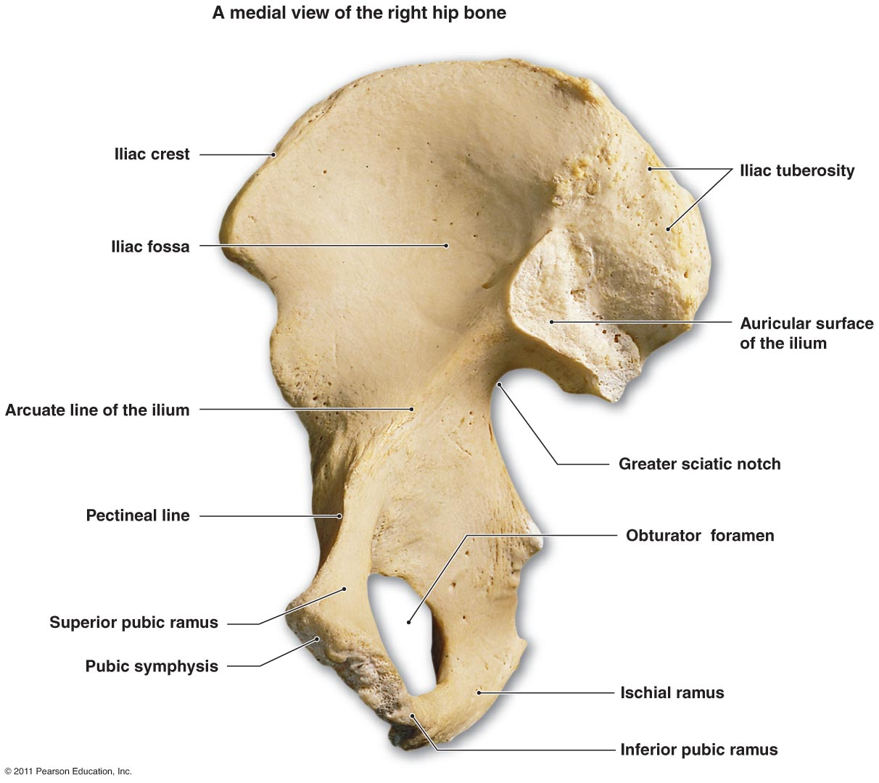

Slide 7
Hip movement and the muscles that help them move
Hip Movement | Muscles used for movement
Hip Flexion | Rectus femoris; Sartorius; Illiacus; Psoas
Hip Extension | Hamstrings; Biceps femorus; Semimembranosis; Semitendinosis; Gluteus maximus
Hip Abduction | Gleteus medius; tensor fascia lata
Hip Adduction | Gracilis; Pectineus; Adductor magnus; Adductor longus; Adductor brevis
Hip Medial rotation | Gluteus minimus
Hip Lateral rotation | Piriformis; Superior gemelllus; Inferior gemellus; Obturator internus; Obturator exernus; Quadratus femoris

Slide 8
Injuries of the Thigh, Hip, Groin, and Pelvic region
Quadriceps Contusions
Myositis Ossificans
Quadriceps Muscle Strain
Hamstring Muscle Strain
Acute Femoral Fracture
Hip Sprain
Dislocated Hip Joint
Hip Labral Tear
Piriformis Syndrome
Legg-Perthes Disease
Slipped Capital Femoral Epiphysis
Iliac Crest Contusion (Hip pointer)
Osteitis Pubis
Stress Fracture of the Pelvis
Avulsion Fracture

