Slide 1
The Knee

Slide 2
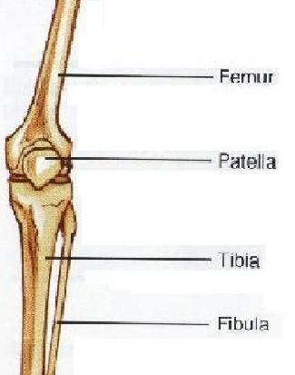
Bones of the Knee
Femur
Fibula
Tibia
Patella

Slide 3
Rattle Me Bones….
The four bones make up several articulations:
Femur & Tibia
Femur & Patella
Femur & Fibula
Tibia & Fibula
The articulations are enveloped by the largest joint capsule in the body.

Slide 4
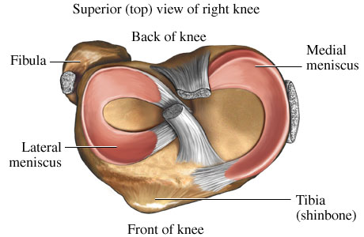
Meniscus

Slide 5
Meniscus
Medial and Lateral meniscus are fibrocartilage disks that are shaped like bowls, thicker on the outside border and thinner on the inside. They lie on top of the tibial plateau and function to make the rounded femoral condyles fit.

Slide 6
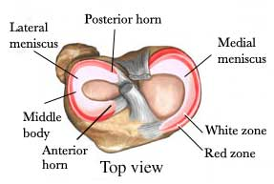
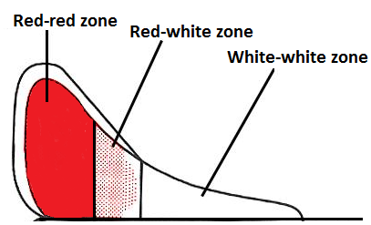
Meniscus
Meniscus have poor blood supply which can impede heeling.

Slide 7
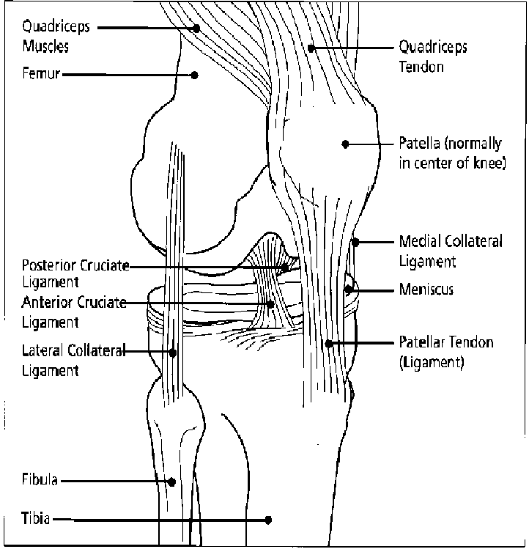
Ligaments of the Knee
MCL – Medical Collateral Ligament
ACL – Anterior Cruciate Ligament
PCL – Posterior Cruciate Ligament
LCL – Lateral Collateral Ligament

Slide 8
Ligaments / ACL (anterior cruciate ligament)
ACL prevents the tibia from moving forward relative to the femur during knee flexion and the femur from sliding backward when the knee is extended along with general stability during weight bearing activities. The ACL provides the tibia with stabilization to prevent excessive internal rotation and serves as a secondary stabilizer when the collateral ligaments become injured.

Slide 9
Ligaments / PCL (posterior cruciate ligament)
The PCL prevents the tibia from sliding backward relative to the femur when the knee is flexed, and the femur from sliding forward when the knee is extended.

Slide 10
Ligaments / MCL (medial collateral ligament)
MCL attaches on the medial condyle of the femur and inserts below the joint line on the tibia.
It’s major function is to protect the knee from valgus forces that are applied to the lateral surface and resist external tibial rotation.
Two portions of the MCL include superficial and deep portions. The medial meniscus attaches to the deep portion of the medial collateral ligament.

Slide 11
Ligaments / LCL (lateral collateral ligament)
The LCL is attached to the lateral condyle of the femur and the head of the fibula.
LCL resists varus forces that are applied to the medial surface of the knee.
The LCL and MCL are the tightest during knee extension, but relaxed during knee flexion.

Slide 12
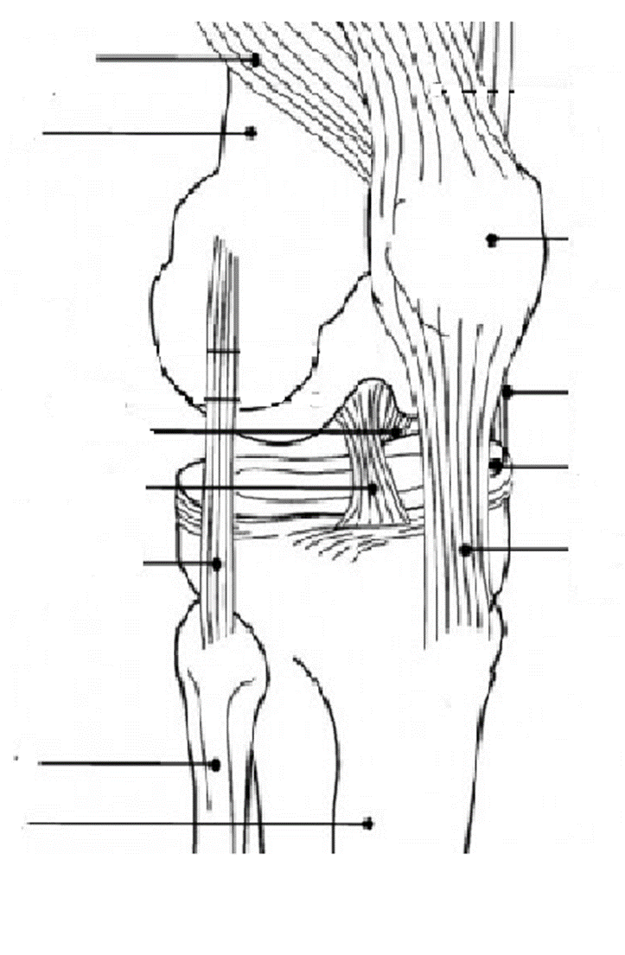

Slide 13
Muscles
Quadriceps (Anterior Muscle Group)
Rectus Femoris
Vastus Medialis
Vastus Lateralis
Vastus Intermedius
Hamstrings (Posterior Muscle Group)
Semitendinosus
Semimembranosus
Biceps Femoris

Slide 14
Muscles of the knee joint and movement
Knee Flexion | Hamstring group - Bicep femoris - Semitendinosus - Semimembranosis Gracilis Sartorius Gastrocnemius Popliteus Plantaris
Knee Extension | Quadriceps group - Vastus medialis oblique - Vastus lateralis - Vastus intermedius - Rectus femoris
External Tibial Rotation | Biceps femoris
Internal Tibial Rotation | Popliteus Semitendinosus Semimembranosus Sartorius Gracilis

